Slide 1
Cell Signaling Regulation via Post-translational Modifications
Saint Louis University
Biology Department
Xin (Randy) Jin

Slide 2
Outline
Ras1 phosphorylation and its role in regulating macroautophagy
Regulating oxidative stress responses by a deubiquitinating enzyme Ubp3 and a mitogen-activated protein kinase Mpk1

Slide 3
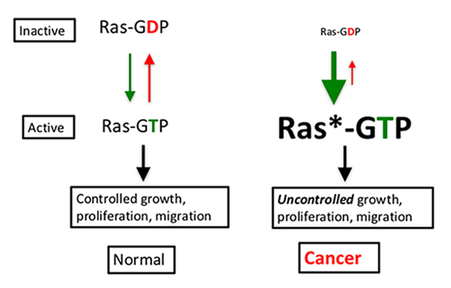
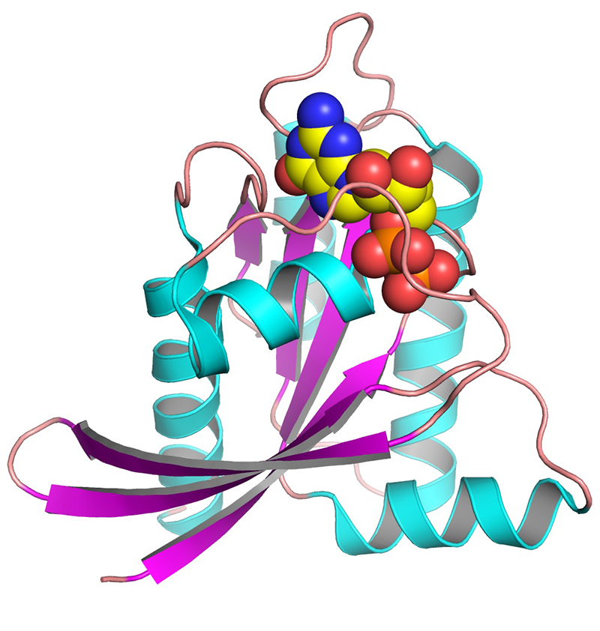
Ras proteins are important small GTPases that control cell growth and proliferation

Slide 4
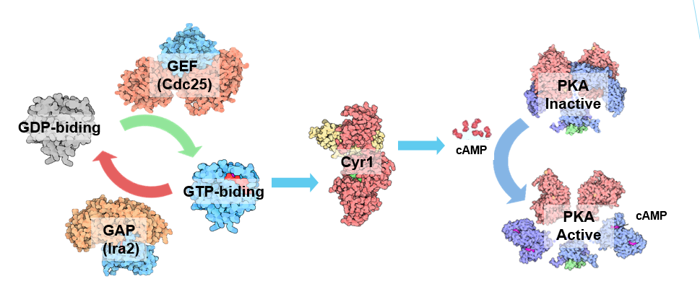
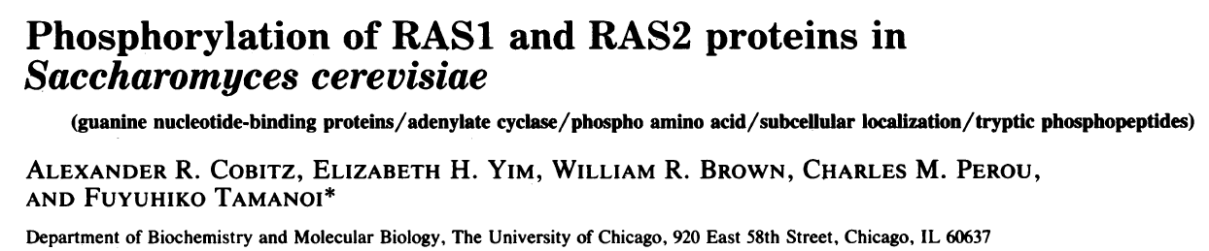
Ras-mediated signaling in yeast

Slide 5
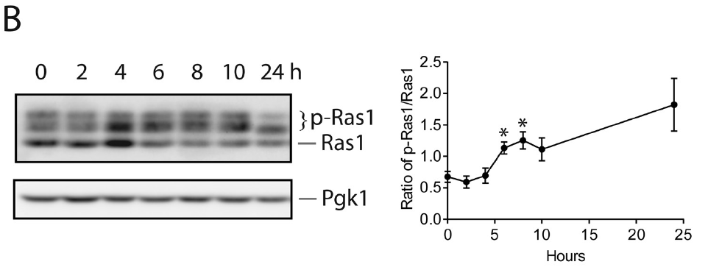
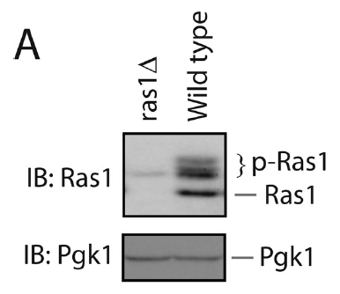
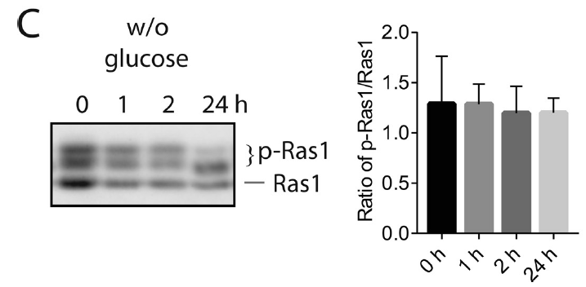
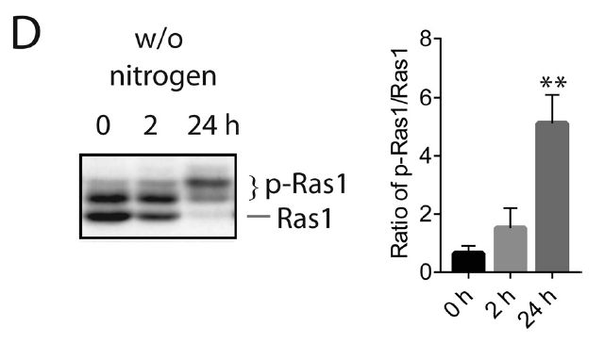
Ras1 phosphorylation is regulated by the nutrient status

Slide 6
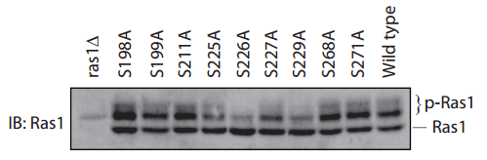
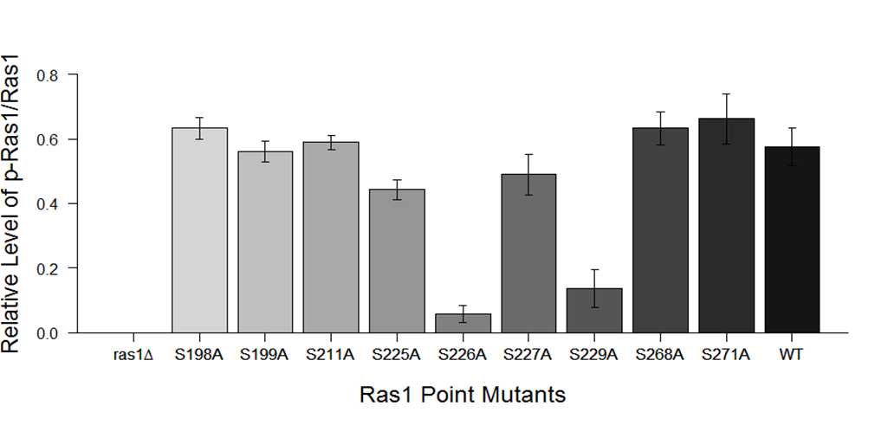
Ser226 is required for basal Ras1 phosphorylation

Slide 7
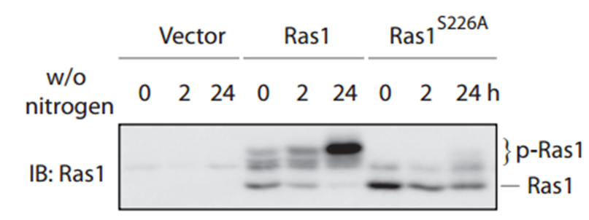
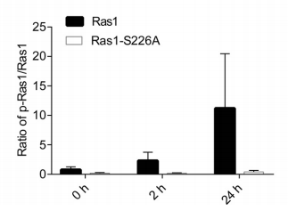
Ser226 is required for Nitrogen Starvation-Induced Ras1 phosphorylation

Slide 8
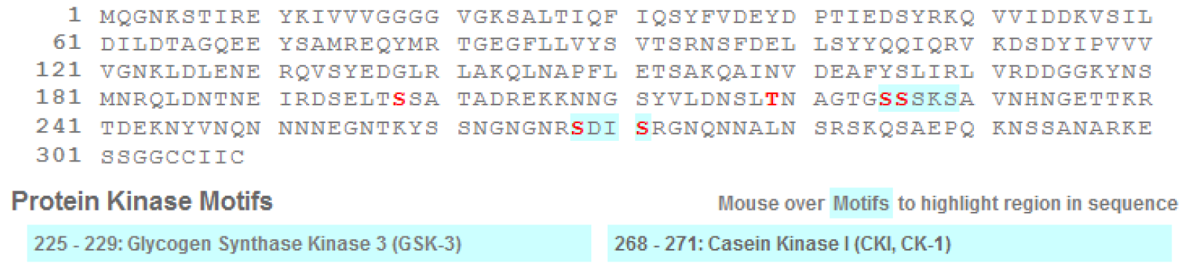
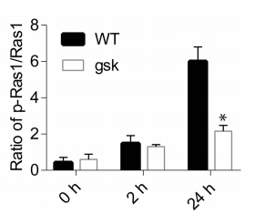
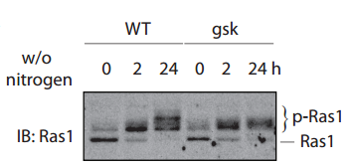
Glycogen Synthase Kinase is Required for Ras1 Phosphorylation

Slide 9
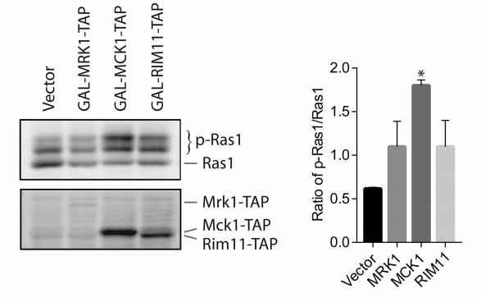
Overexpressing GSK elevates the level of Ras1 Phosphorylation

Slide 10
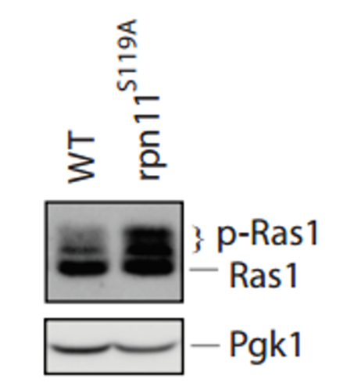
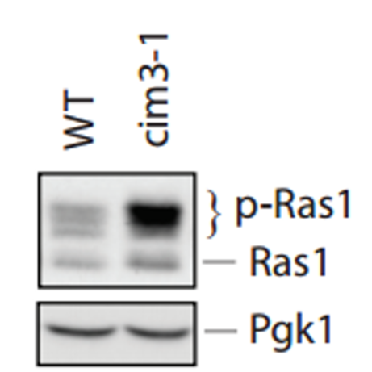
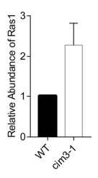
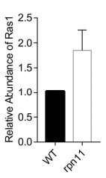
Accumulating phosphorylated Ras1 in the proteasome-deficient mutants

Slide 11
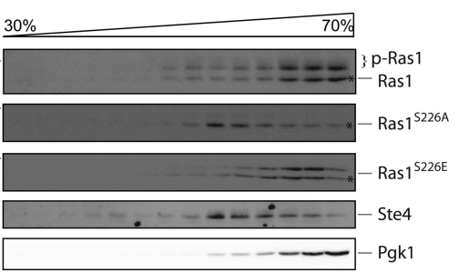
Phosphorylation regulates subcellular localization of Ras1

Slide 12
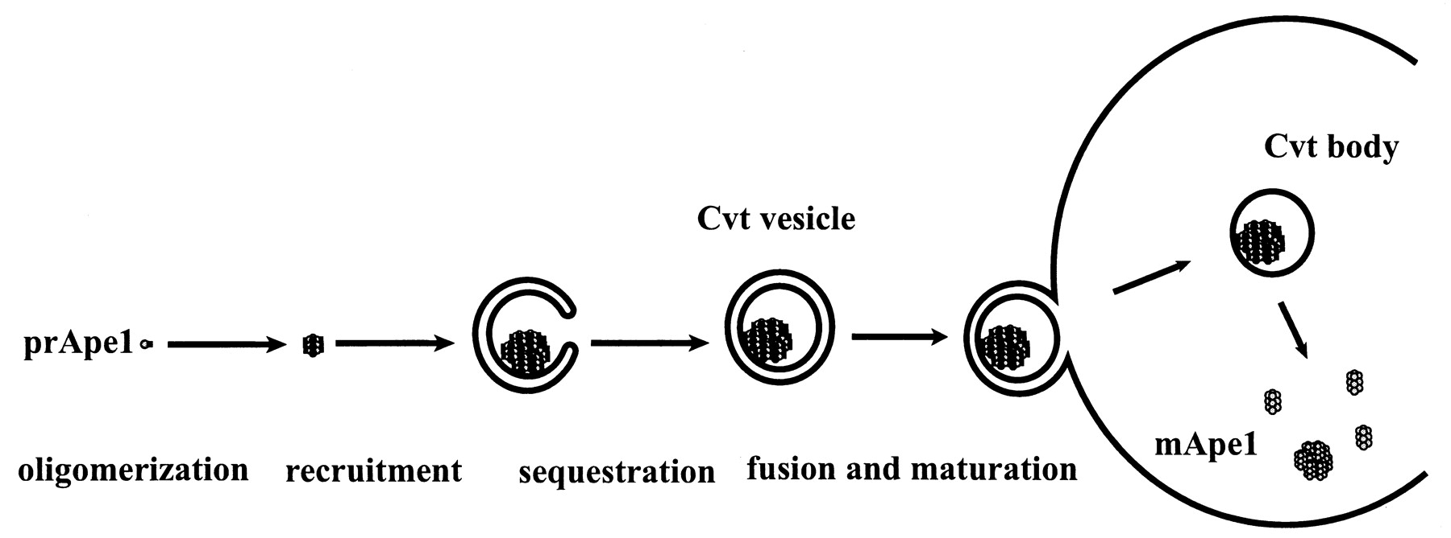
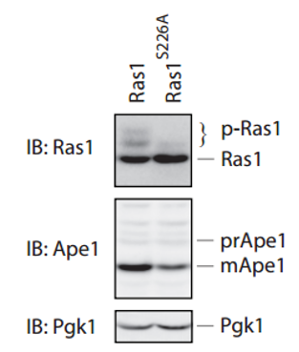
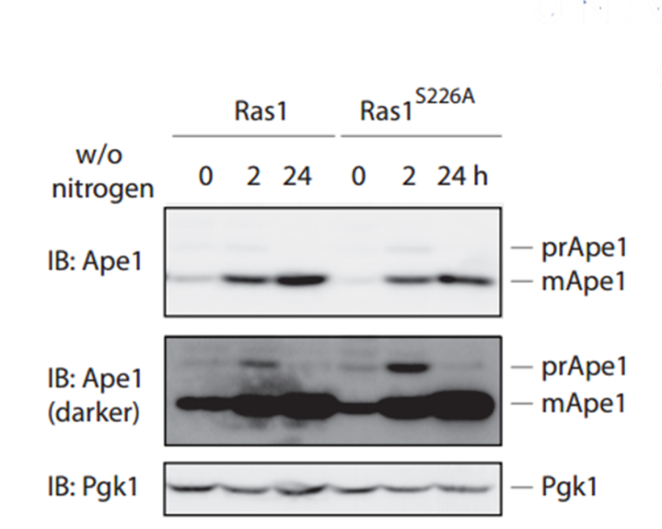
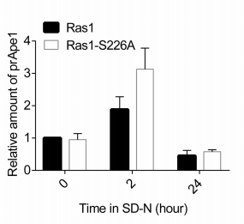
Blocking Ras1 phosphorylation impairs the cytoplasm-to-vacuole (cvt) pathway

Slide 13
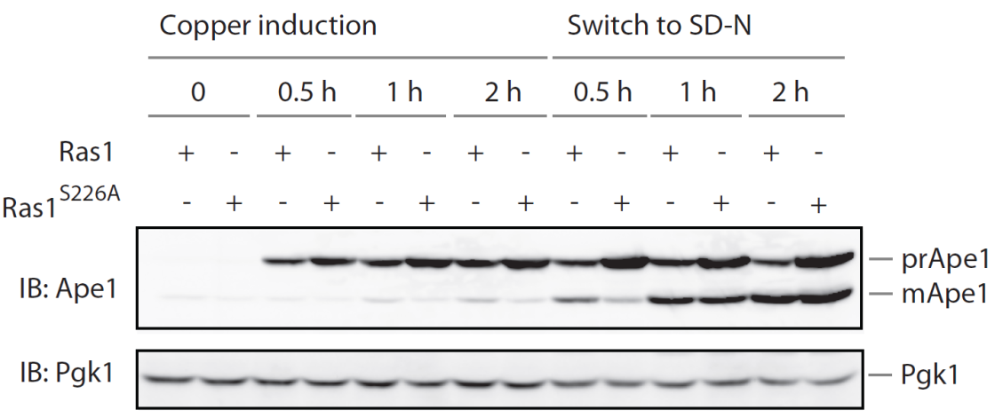
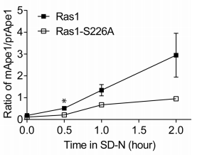
Blocking Ras1 phosphorylation impairs the cytoplasm-to-vacuole (cvt) pathway

Slide 14
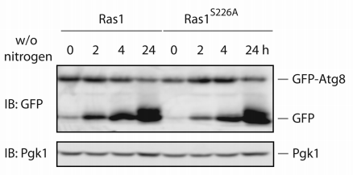
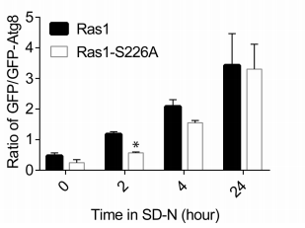
Blocking Ras1 phosphorylation impairs the cvt pathway and macroautophagy

Slide 15
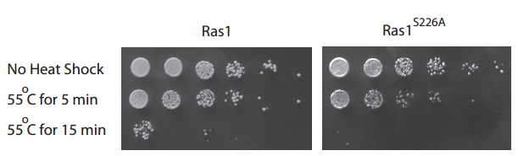
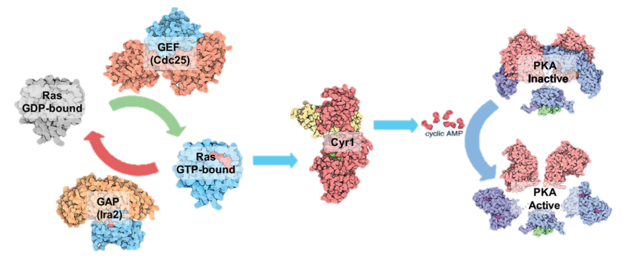
Blocking Ras1 phosphorylation renders cells more sensitive to heat shock

Slide 16
Conclusions
Ras1 phosphorylation is stimulated by nitrogen starvation condition
Glycogen synthase kinase (GSK) is required for maximal phosphorylation of Ras1
Phosphorylation impairs plasma membrane localization of Ras1 protein and elevates cellular stress responses (autophagy and heat tolerance)

Slide 17
Outline
Ras1 phosphorylation and its role in regulating macroautophagy
Regulating oxidative stress responses by a deubiquitinating enzyme Ubp3 and a mitogen-activated protein kinase Mpk1

Slide 18
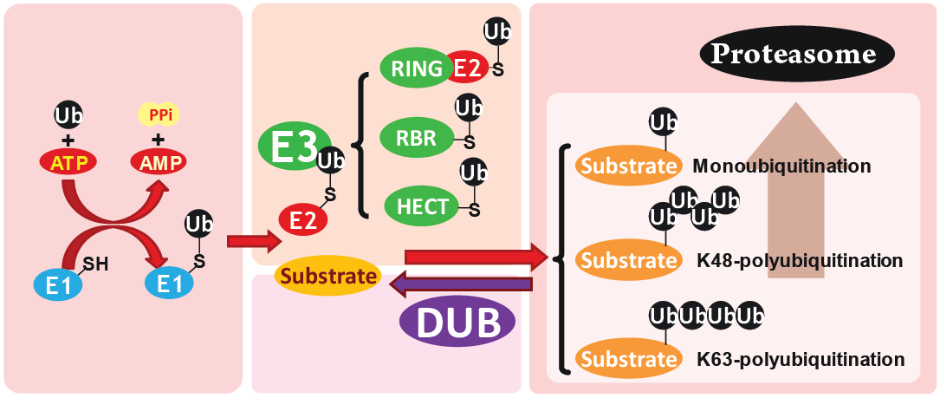
Ubiquitination and DUBs

Slide 19
UBP3 Ubiquitin-Specific Protease
Ubp3
Bre5
Usp10
G3BP
USP10 (Human Ortholog USP)
Regulator
p53 Tumor Repressor Gene
Sirt6 DNA Damage Repairment
BECN1 autophagy, PIK3C3/VPS34 complexes
Prognostic Factor for Gastric Carcinoma

Slide 20
UBP3 Ubiquitin-Specific Protease
Ubp3
Bre5
Usp10
G3BP
UBP3: Thiol-Dependent
Ubp3-Bre5 Deubiquitination complex
Response to DNA replication stress
In response to osmo-stress
Hog1: Phosphorylation at Ser695
RNA Polymerases
Transportation between ER and Golgi

Slide 21
Oxidative Stress
Toxic Effects ⬄ Aging/Cancer
Peroxides and Free Radicals
Damage all Cellular Components
DNA
Protein
Lipid
Mitochondria and Peroxisome

Slide 22
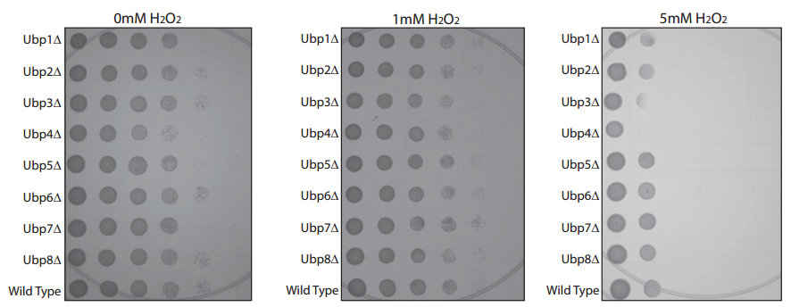
ubp3Δ mutant is sensitive to oxidative stress

Slide 23
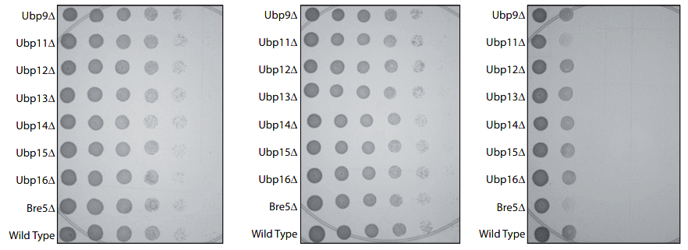
bre5Δ mutant is also sensitive to oxidative stress

Slide 24
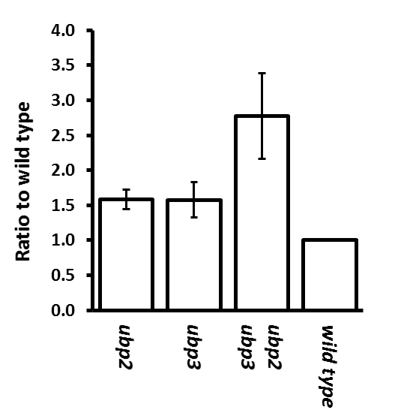
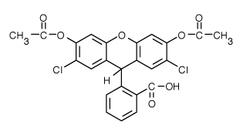
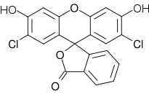
ubp3 mutant has higher level of intracellular ROS
dichlorodihydrofluorescein diacetate H₂DCFDA
***
***
***

Slide 25
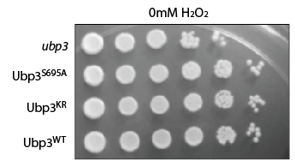
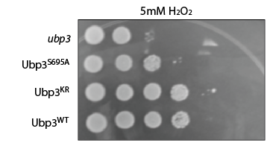
Blocking Ubp3 phosphorylation at Ser695 renders cells more sensitive to oxidative stress
VPSP

Slide 26
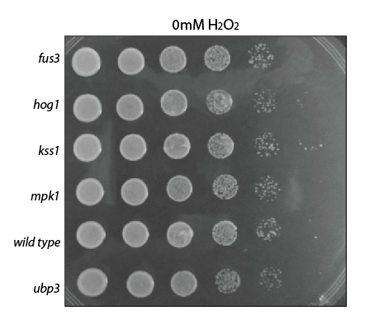
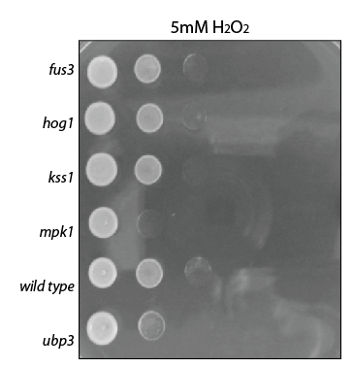
Disrupting MPK1 but not any other MAPK renders cells more sensitive to oxidative stress

Slide 27
Similar to ubp3 mutant, mpk1 mutant has higher level of intracellular ROS
***
***
*

Slide 28
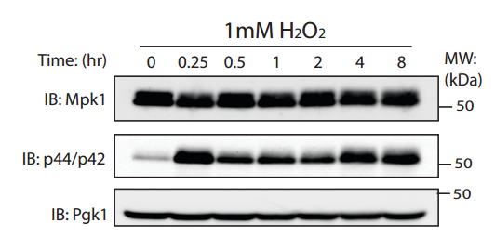
Oxidative Stress triggers Mpk1 activation

Slide 29
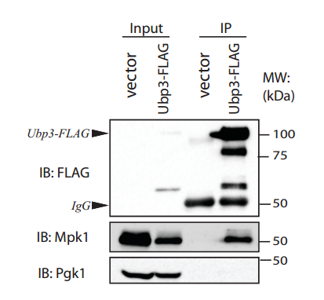
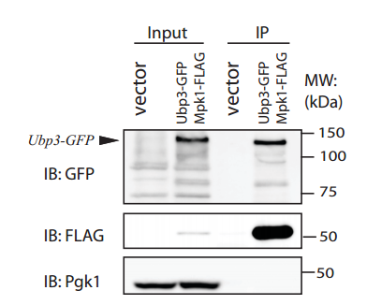
Mpk1 interacts with Ubp3

Slide 30
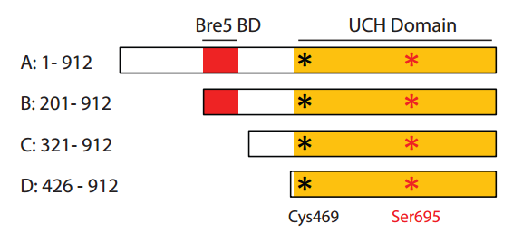
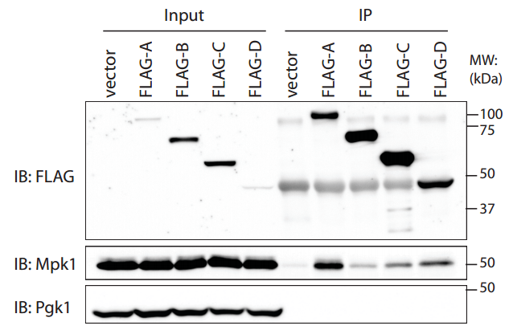
UCH domain of Ubp3 is sufficient to interact with Mpk1

Slide 31
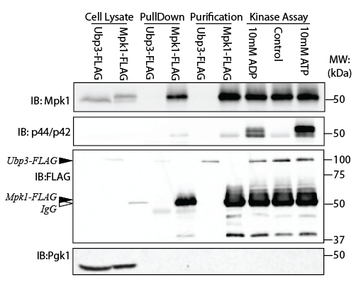
Kinase Assay
To Be Continued…

Slide 32
Future Direction
In vitro kinase assay to determine whether Mpk1 phosphorylates Ubp3 on Ser695
Determine if the effect of Ubp3-S695A mutant is dependent on Mpk1
Determine how Ubp3 is regulated by its phosphorylation on Ser695
Catalytic Activity
Subcellular localization
Stability

Slide 33
Regulation Of Membrane Protein Ubiquitination By Prenylated Miy1 In Yeast
Saint Louis University
Biology Department
Dr. Yuqi Wang’s Lab
Xin Jin (Randy)

Slide 34

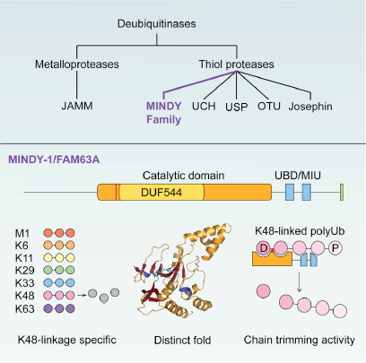
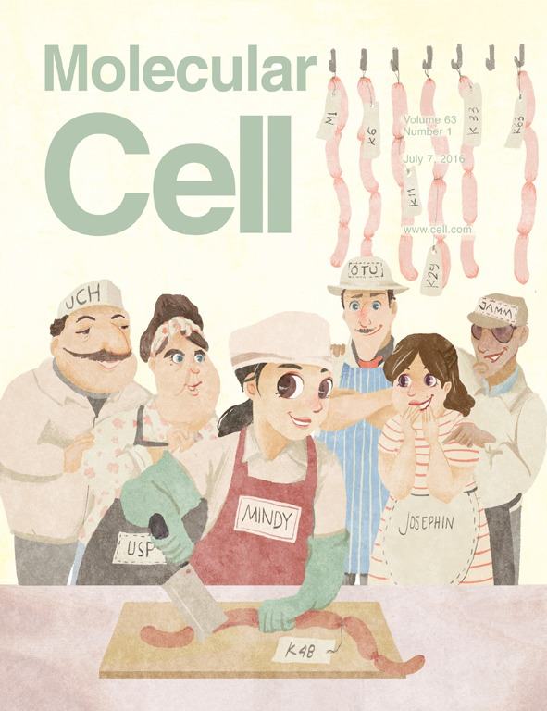
Miy1(MINDY-1) Is a New Family of Deubiquitinating Enzymes

Slide 35
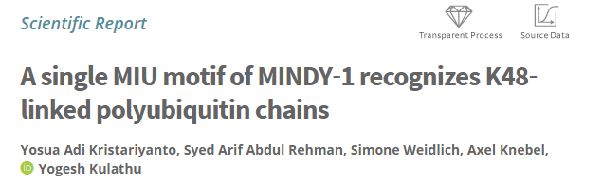



MIU motif of MINDY‐1 recognizes K48‐linked polyubiquitin chains

Slide 36


Protein Prenylation
Marcos Malumbres & Mariano Barbacid,RAS oncogenes: the first 30 years [J] Nature Reviews Cancer 3, 459-465 (June 2003) | doi:10.1038/nrc1097

Slide 37


Miy1 is a Prenylated, Membrane-Binding Protein
FLAG-Miy1
GFP-FLAG-Miy1

Slide 38

Prenylation is required for anchoring Miy1 to membrane
CAAX is essential for the Localization of Miy1
GFP-Miy1^{wt}/ by4741
GFP-Miy1 ^{C357S} /by4741
GFP-Miy1 ^{C357*Stop} /by4741

Slide 39
Prenylation is required for anchoring Miy1 to membrane
Ram1 is β subunit of CAAX farnesyltransferase (FTase)
GFP-Miy1^{wt}/ by4741
GFP-Miy1^{wt}/ ram1
GFP-Miy1 ^{C357S} /by4741

Slide 40


Miy1 localizes at Nuclear peripheral ER and Cellular Membrane

Slide 41

Miy1 localizes at Nuclear peripheral ER and Cellular Membrane

Slide 42



Miy1 Mainly Regulates Membrane Protein Ubiquitination

Slide 43


Miy1 Mainly Regulates Membrane Protein Ubiquitination

Slide 44

Rce1 mutant influences Miy1 mobility

Slide 45


Miy1 affects Ste2 modification
?
Poly-Ubi
Ubi
Poly-Ubi
Ubi
Poly-Ubi

Slide 46
Something Beyond: Miy1 is controlled by environmental pH
pH5.0
pH6.0
pH7.0
pH8.0
pH9.0
pH10.0
To Be Continued…

Slide 47

Multiple Post-Translational Modifications
4-258
295-312
NH₂
CAAX
310-341

Slide 48

Potential Role Of Miy1 In Regulating Cellular Proteostasis

Slide 49



Acknowledgement:
My PI: Dr. Yuqi Wang
Committee Members:
Dr. Brian Downes
Dr. Haijun Gong
Dr. Jonathan Fisher
Dr. Susan Spencer
Dr. Wenyan Xiao
Lab Members:
Dr. Yang Li
Dr. Xiaolong Lu
Dr. Ethan Bogosian
Undergraduates:
Samuel Stark
Sheetal Sethupathi
Srikrishna Vangipuram
George Kung
Paarth Dodhiawala
Alex Benben

Slide 50
THANKS!

